Slide 1

Z Energy Project - Phase 1 Overview
Enhancing the Station Locator and Fuel Price Features.
Special Team

Slide 2
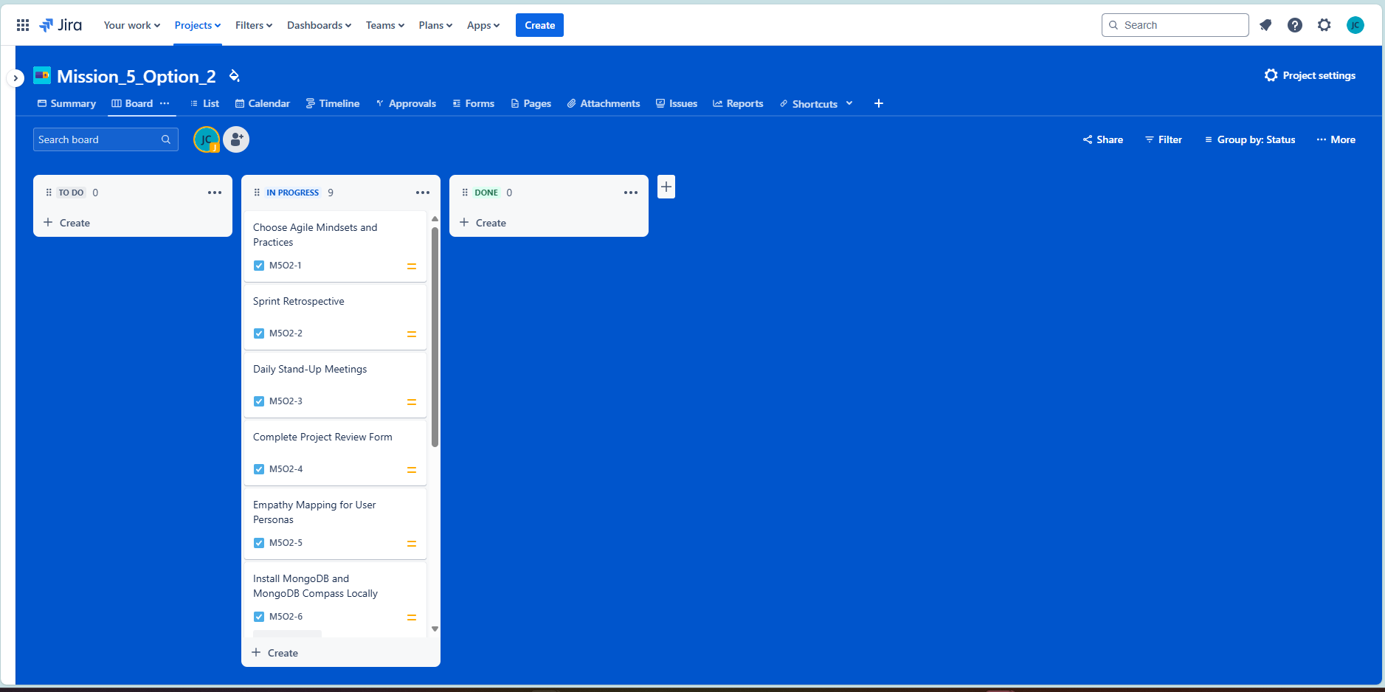
Task 1: Managing Team Tasks with Jira
Objective:
Set up a shared Jira board to manage tasks collaboratively.
Columns:
"To-do", "In-progress", "Done".
High-Level Tasks:
Main tasks and sub-tasks are added and updated by team members.
Notes:
Key Points:
Jira allows us to track progress in real-time.
Clear task ownership and timelines.

Slide 3
Task 2: Daily Stand-Up Meetings
Objective: Perform daily 15-minute stand-ups to track progress.
Focus Points:
What was done yesterday?
What will be done today?
Are there any blockers?
Tools:
Daily updates are added to Jira to track blockers.
Visuals:
Screenshot or table showing start and end times of daily stand-ups.
Key Points:
Stand-ups foster quick problem resolution.
Blockers are identified and addressed.
Notes:
Key Points:
Jira allows us to track progress in real-time.
Clear task ownership and timelines.

Slide 4
Task 3: Agile Mindsets and Practices
Chosen Agile Values:
Individuals and Interactions Over Processes and Tools.
Responding to Change Over Following a Plan.
Agile Practices:
Daily Stand-Ups.
Sprint Retrospectives.
Iterative Development.
Design Thinking:
Empathy Mapping for User Personas.
Notes:
Key Points:
Jira allows us to track progress in real-time.
Clear task ownership and timelines.

Slide 5
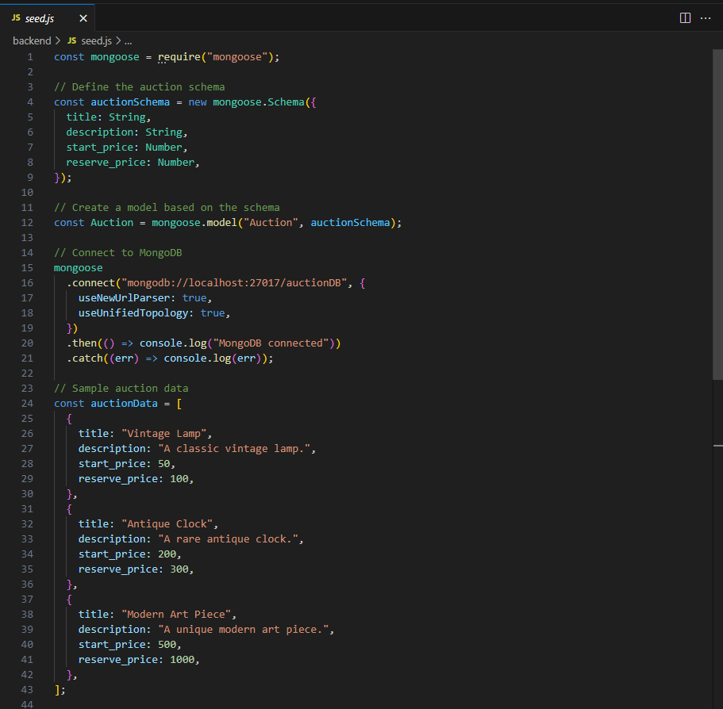
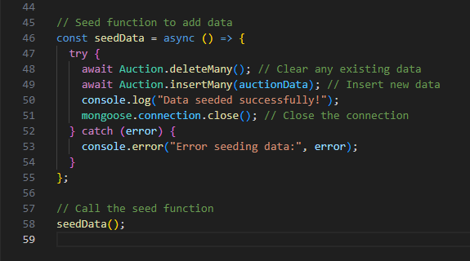
Task 4: Setting Up MongoDB Locally
Objective:
Install MongoDB and MongoDB Compass for local database management.
Command:
npm install mongoose
Files:
Seed.js: Seeding script for MongoDB.
Notes:
Key Points:
Jira allows us to track progress in real-time.
Clear task ownership and timelines.

Slide 6
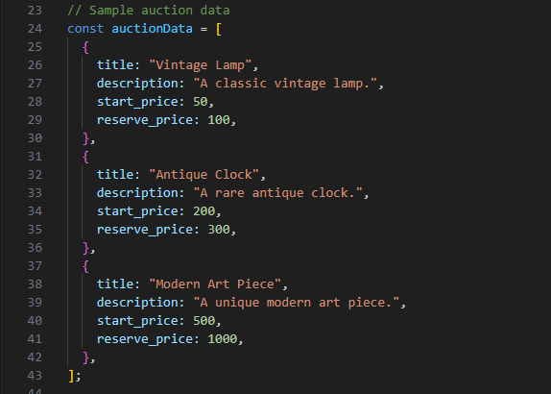
Task 5: Seeding Auction Data into MongoDB
Objective:
Create a CLI tool to seed and delete auction data.
Fields:
Title, description, start price, reserve price.
Files:
Seed.js
Notes:
Key Points:
Jira allows us to track progress in real-time.
Clear task ownership and timelines.

Slide 7
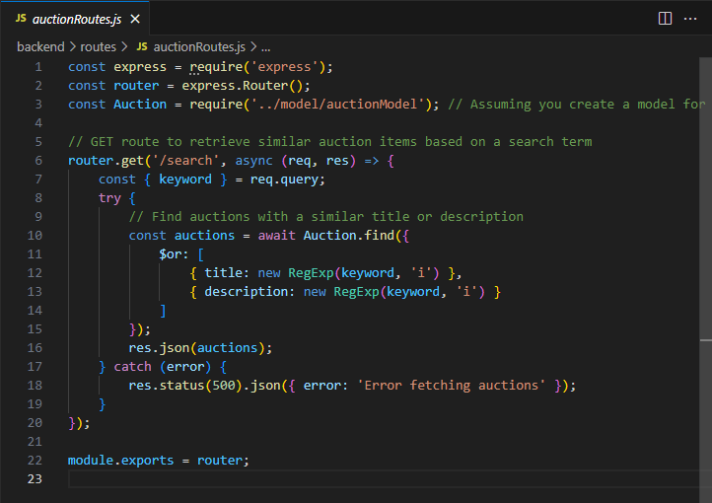
Task 6: API for Displaying Similar Auction Items
Objective:
Create an API to retrieve auction items from MongoDB.
Endpoint:
/api/auctions/search?keyword=lamp
Files:
auctionRoutes.js
Notes:
Key Points:
Jira allows us to track progress in real-time.
Clear task ownership and timelines.

